Slide 1
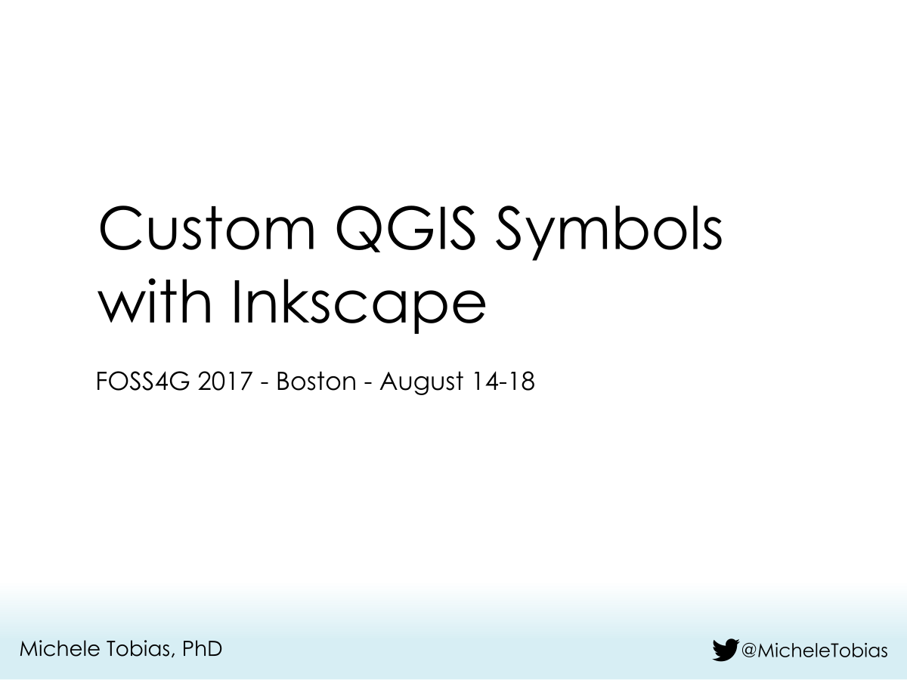

Slide 2
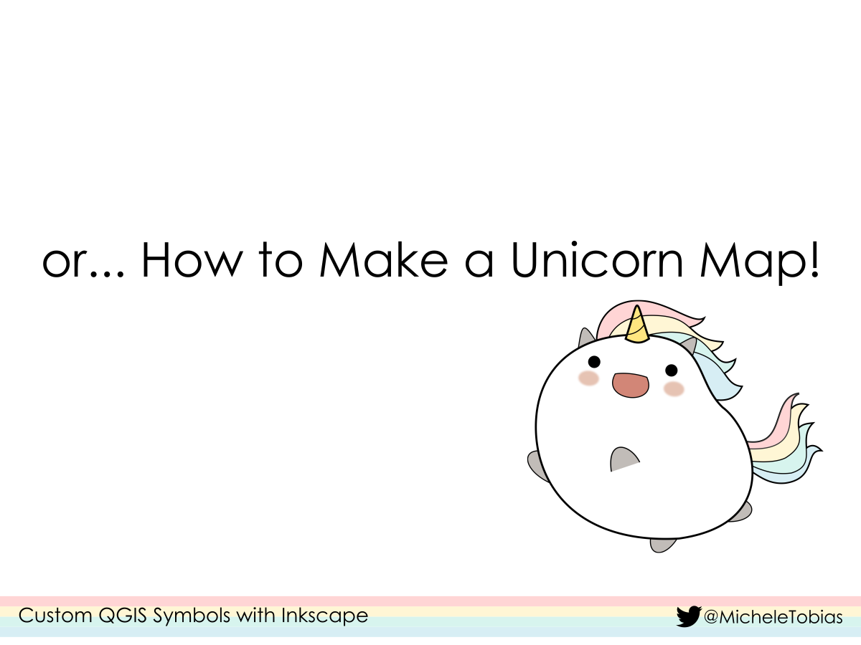

Slide 3
Maybe…
All your maps look the same & you’re ready for something different.
You need a specific icon, but it’s not in QGIS.
You see other maps and wonder where the cartographer got that cool/clever/hipster element.

Slide 4
let’s look at one option:
Inkscape

Slide 5
What is Inkscape?

Slide 6
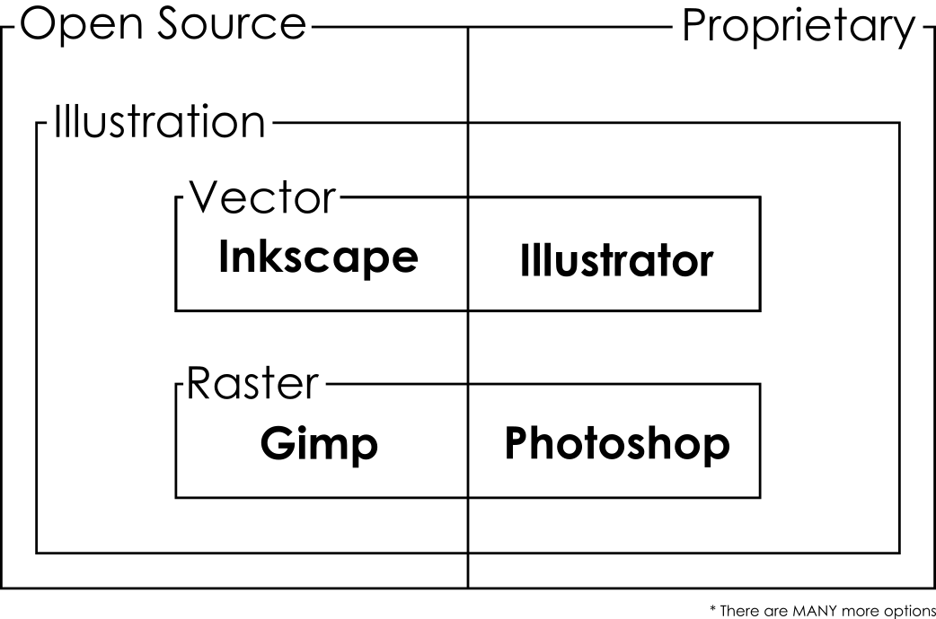

Slide 7
How does Inkscape work with QGIS?
Make an SVG image in Inkscape
QGIS → Layer Properties → Style → SVG Marker/Fill

Slide 8
Ok, enough talking! Let’s make some stuff in Inkscape!

Slide 9
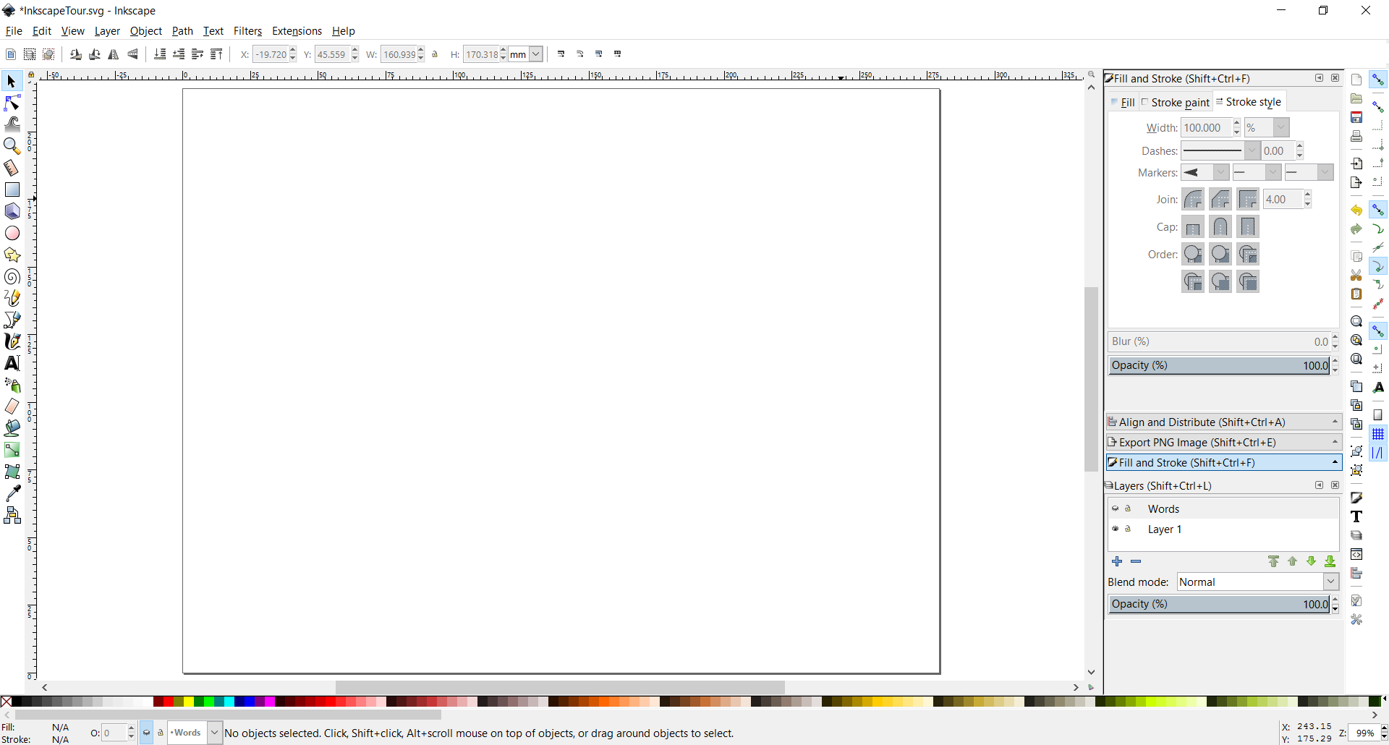

Slide 10
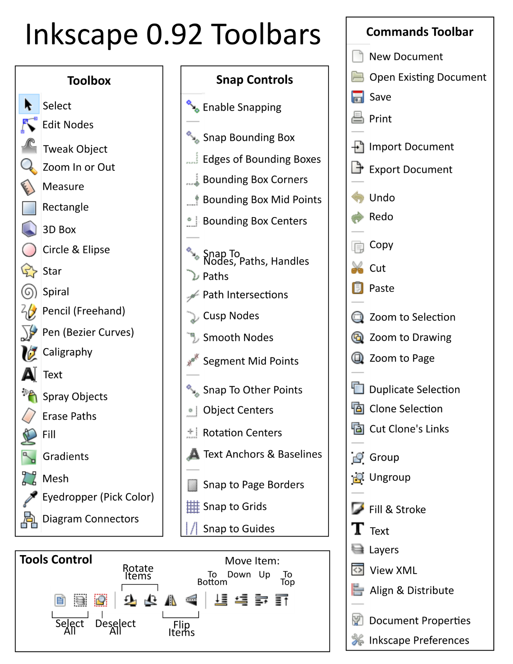

Slide 11
Make some icons

Slide 12
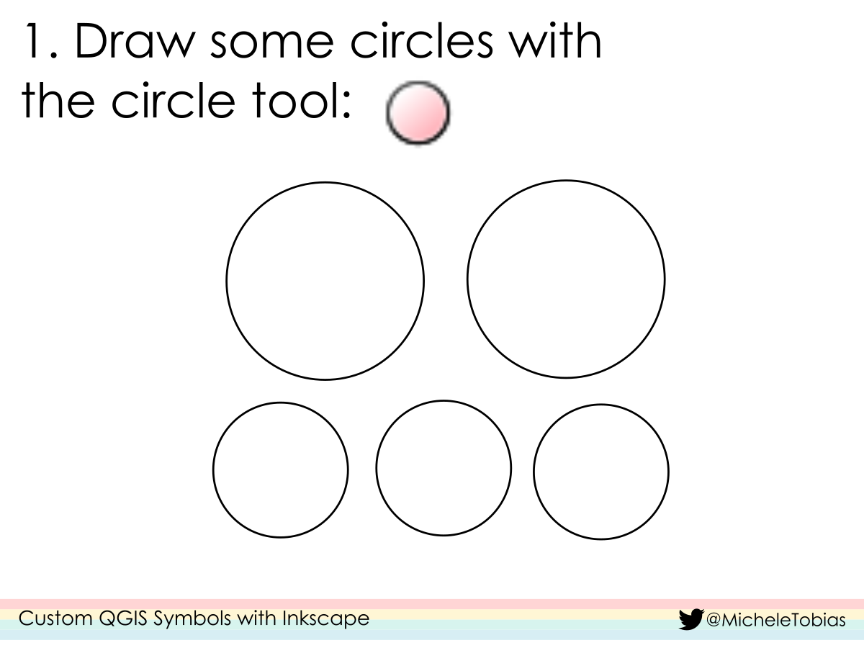

Slide 13
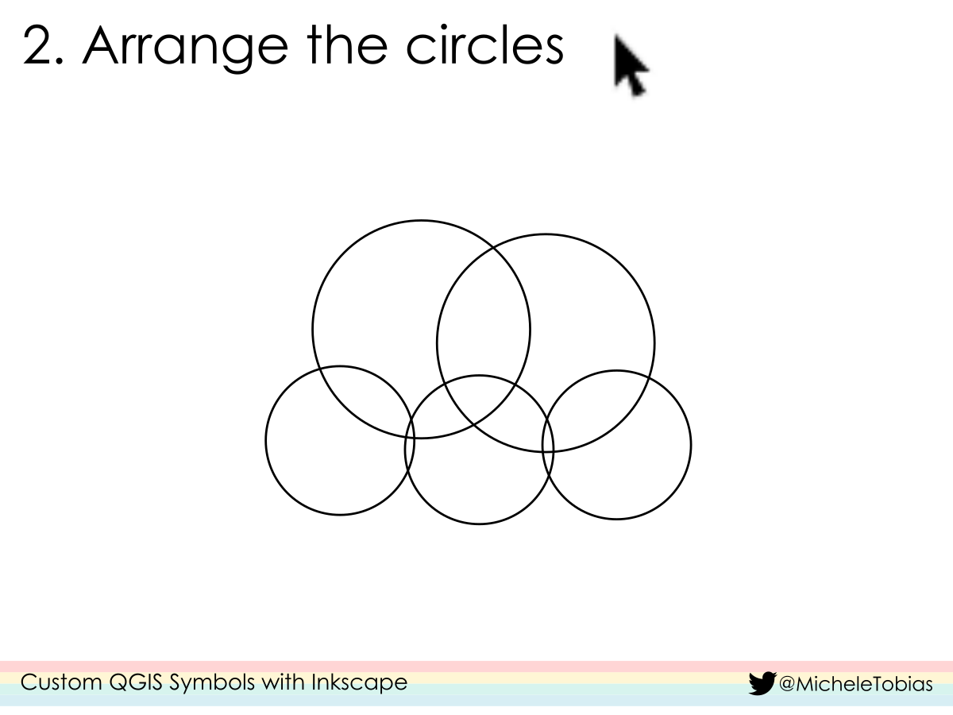

Slide 14
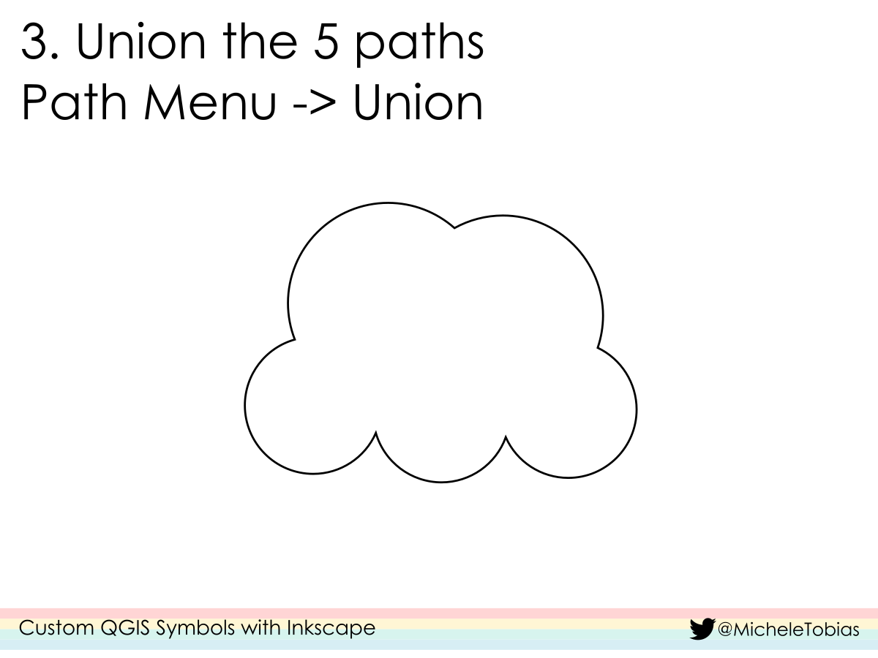

Slide 15
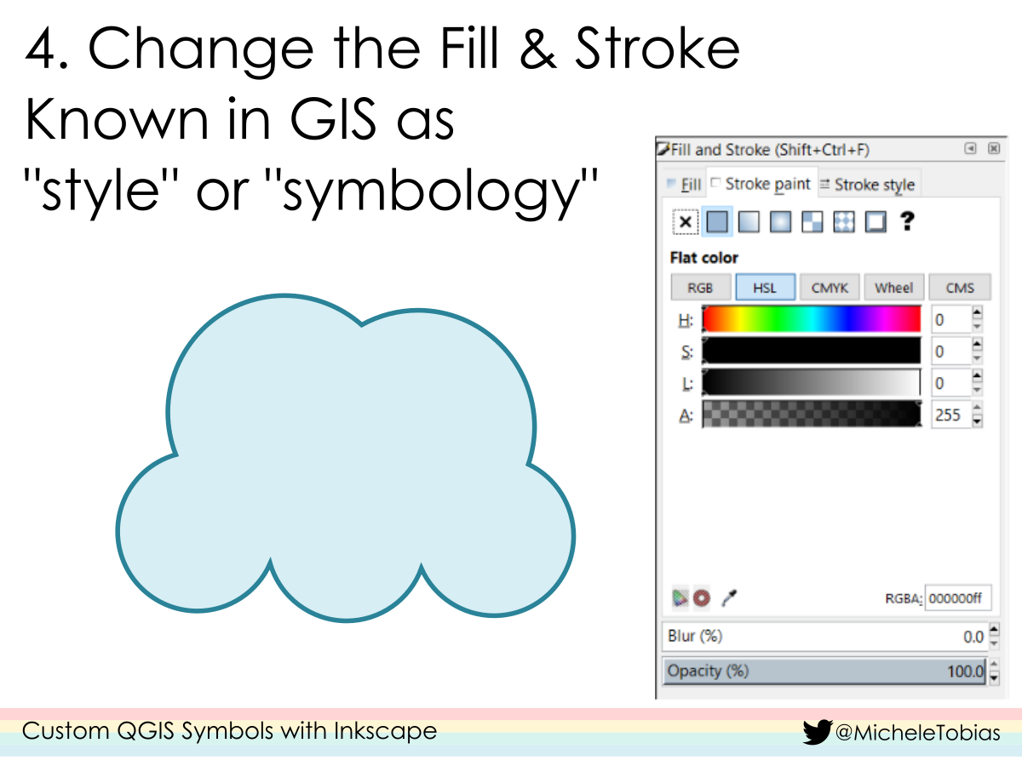

Slide 16
Key Concepts:
Use simple shapes
Layer shapes to create complex items
Skip details = simple is better

Slide 17
Let’s do a few more!

Slide 18
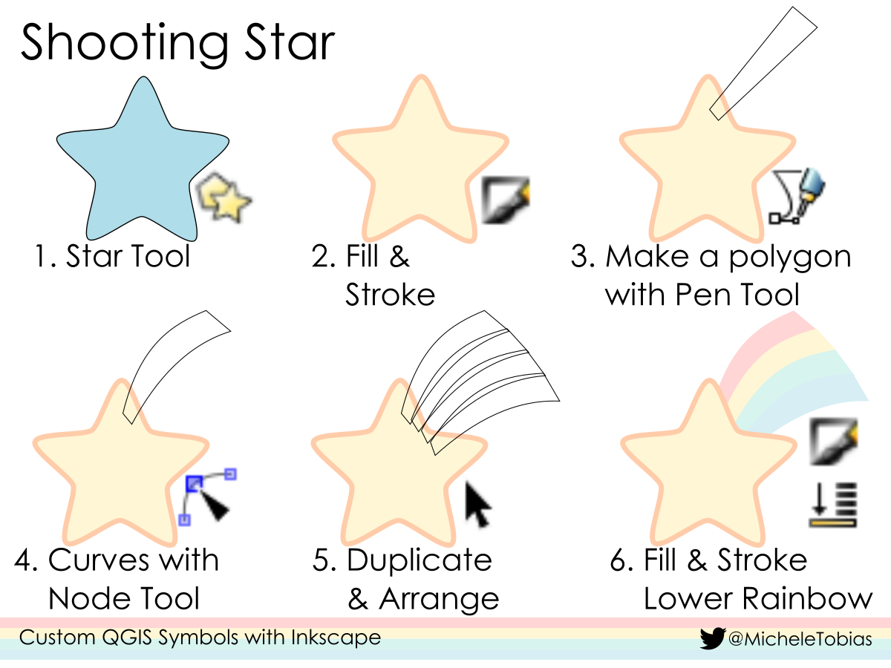

Slide 19
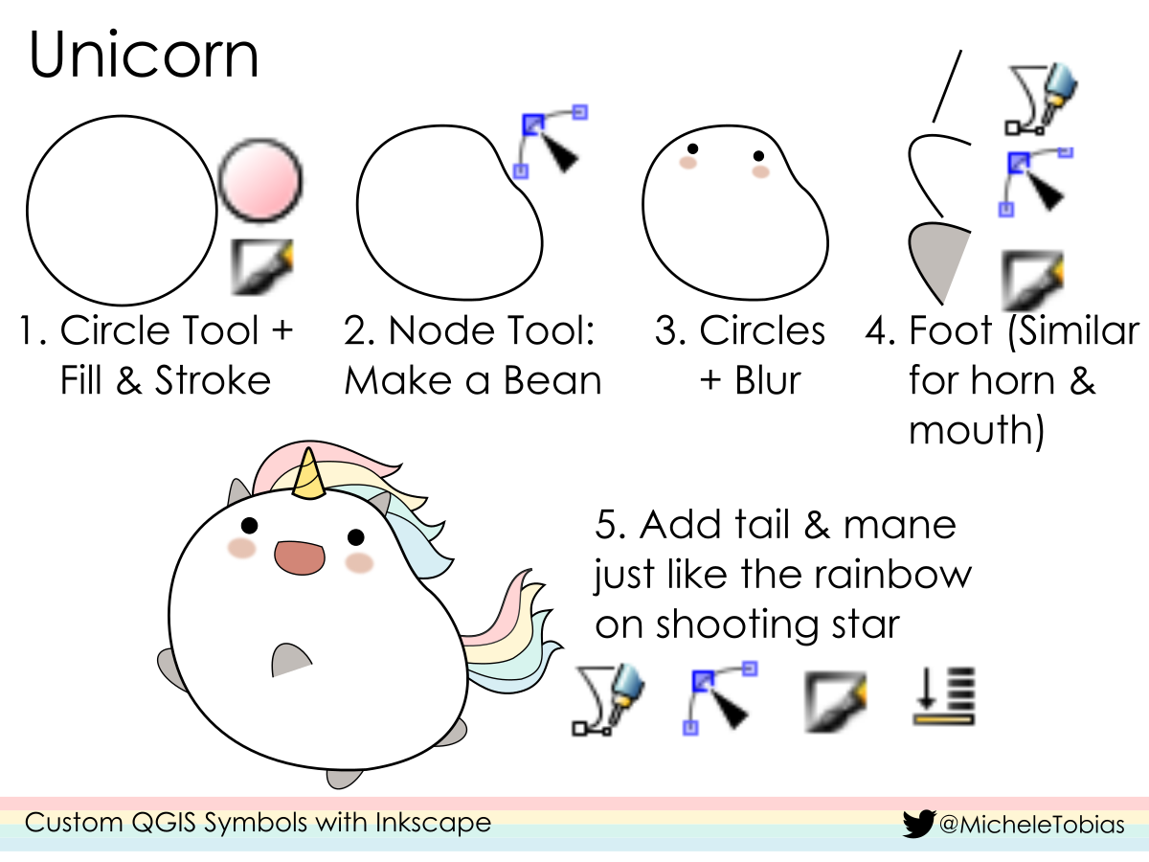

Slide 20
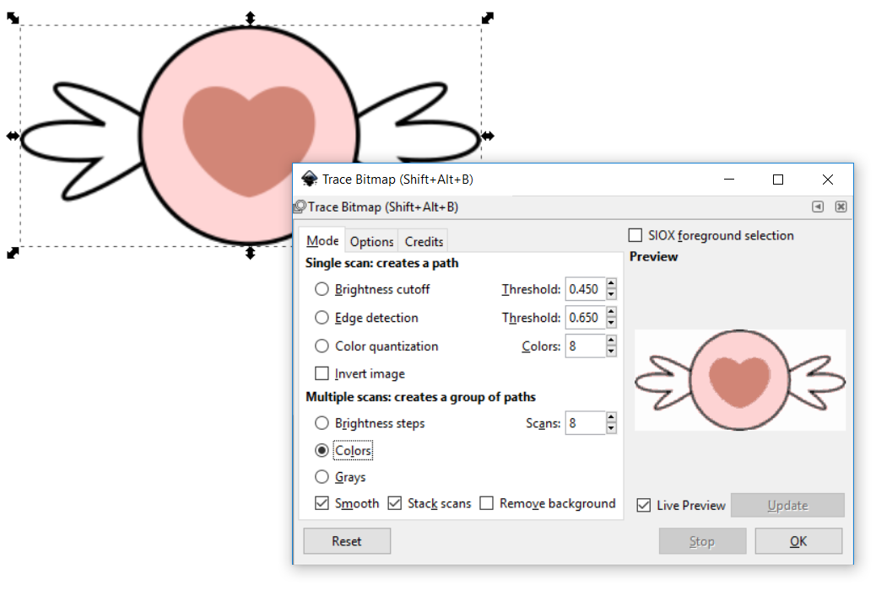
Trace Bitmap
Path menu → Trace Bitmap

Slide 21
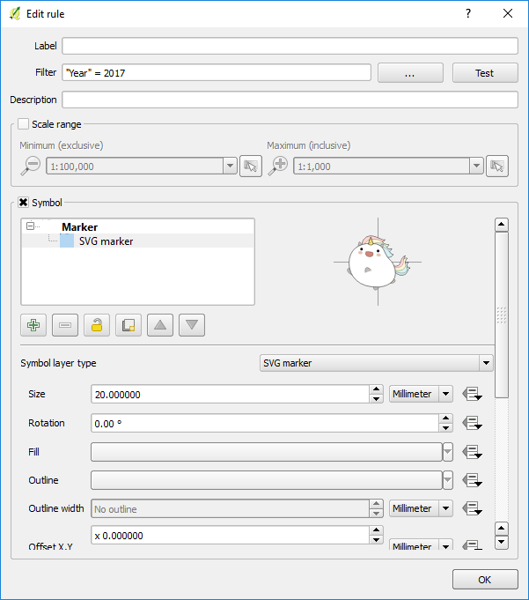
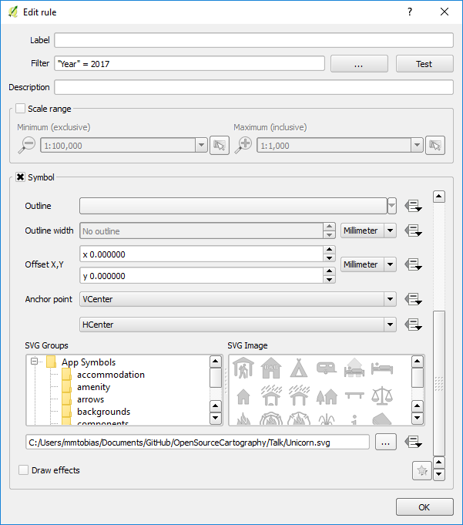
Use them in a map

Slide 22
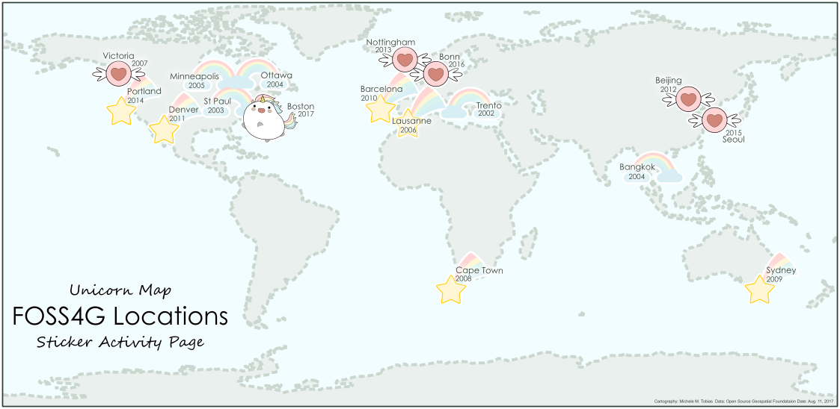

Slide 23
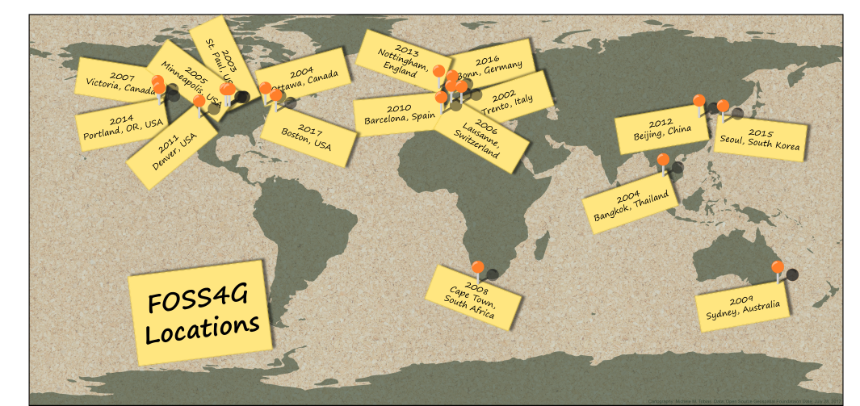

Slide 24
More Resources
Monday’s Cartography Workshop Materials: https://github.com/MicheleTobias/OpenSourceCartography
Cartography Collections for Resources Sharing Plugin: https://github.com/MicheleTobias/QGIS-Cartography-Resources
Inkscape Tutorials: https://inkscape.org/en/learn/

